Slide 1


Parent Workshop

Slide 2
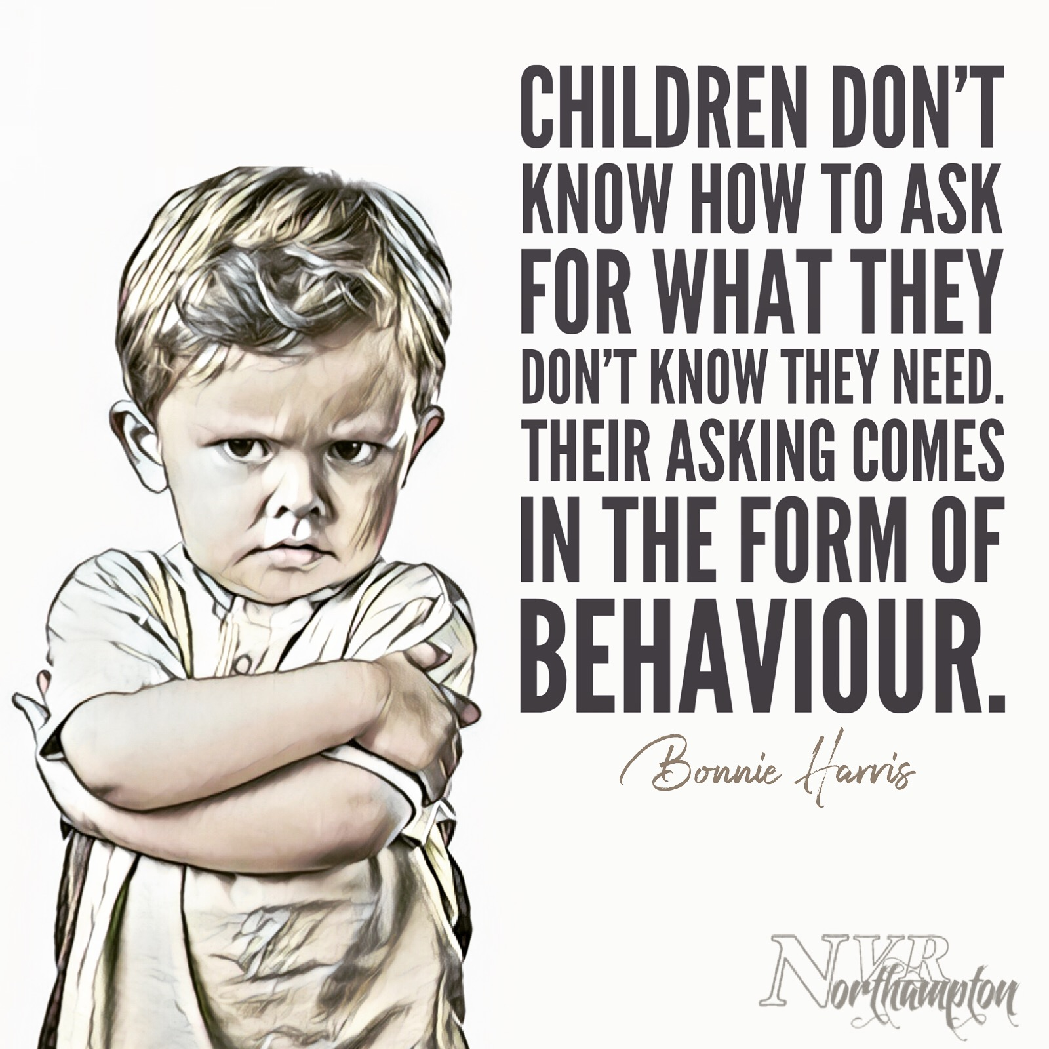
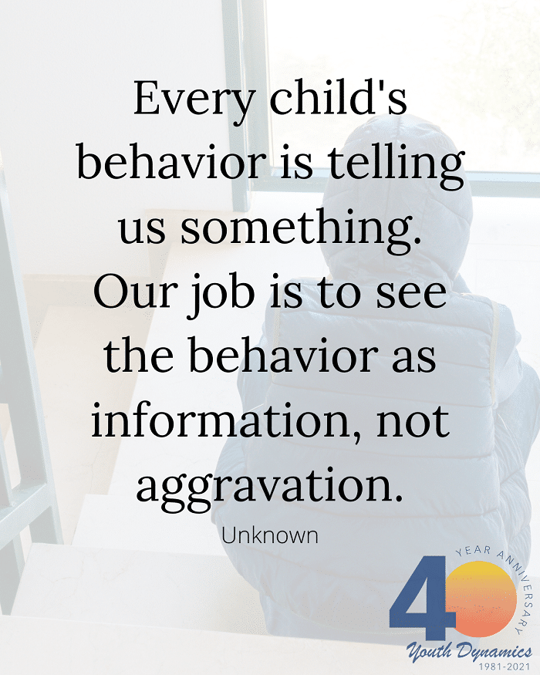

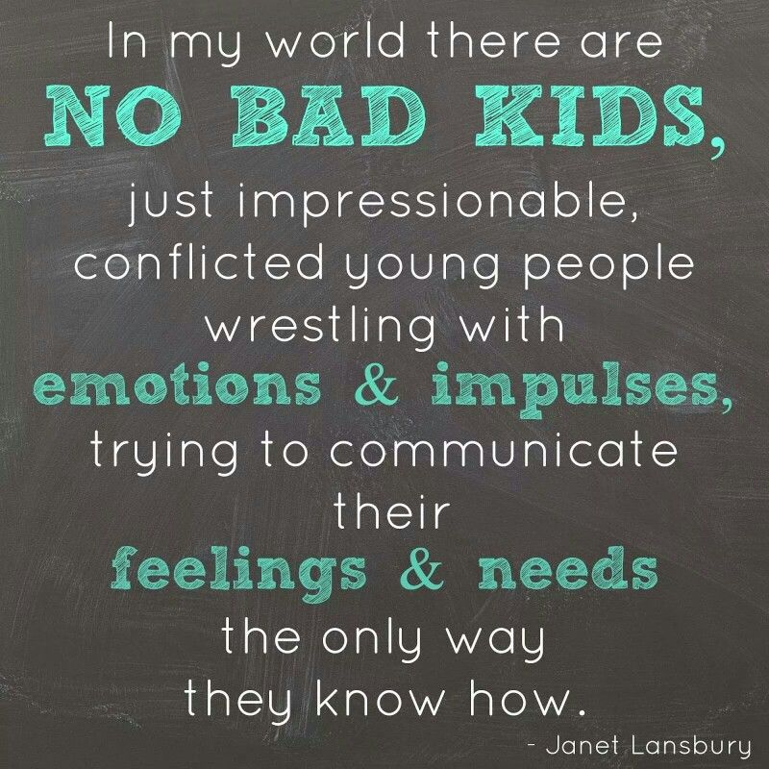

Slide 3
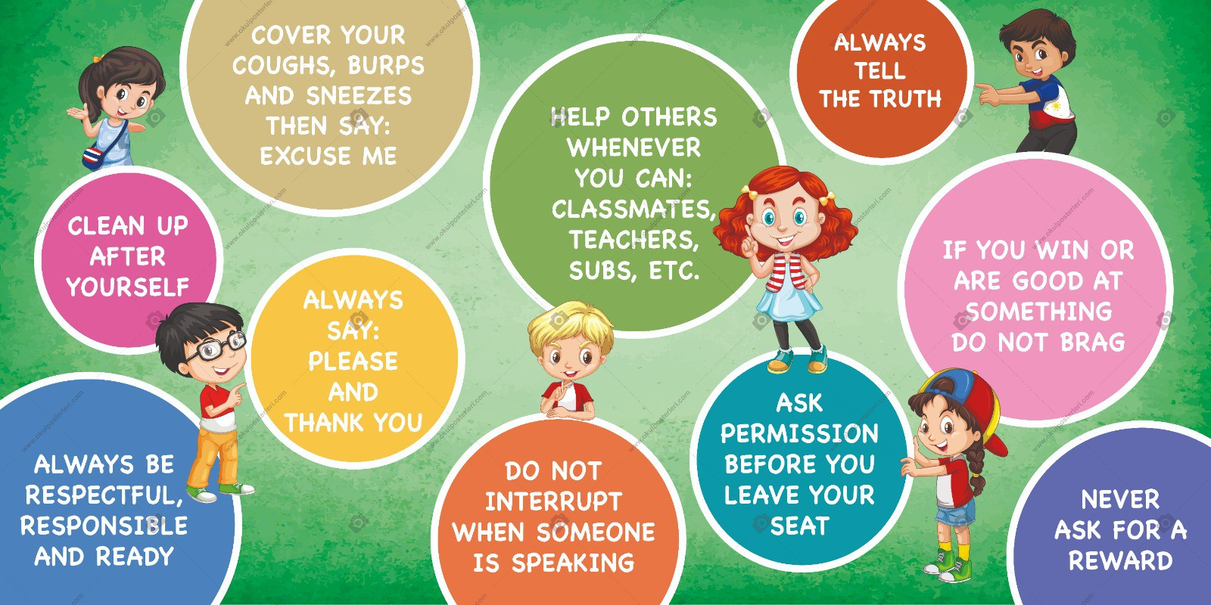
Good Behaviour?

Slide 4




Behaviour influences…
Family
Friends/Social Networks
Social Media/Television

Slide 5
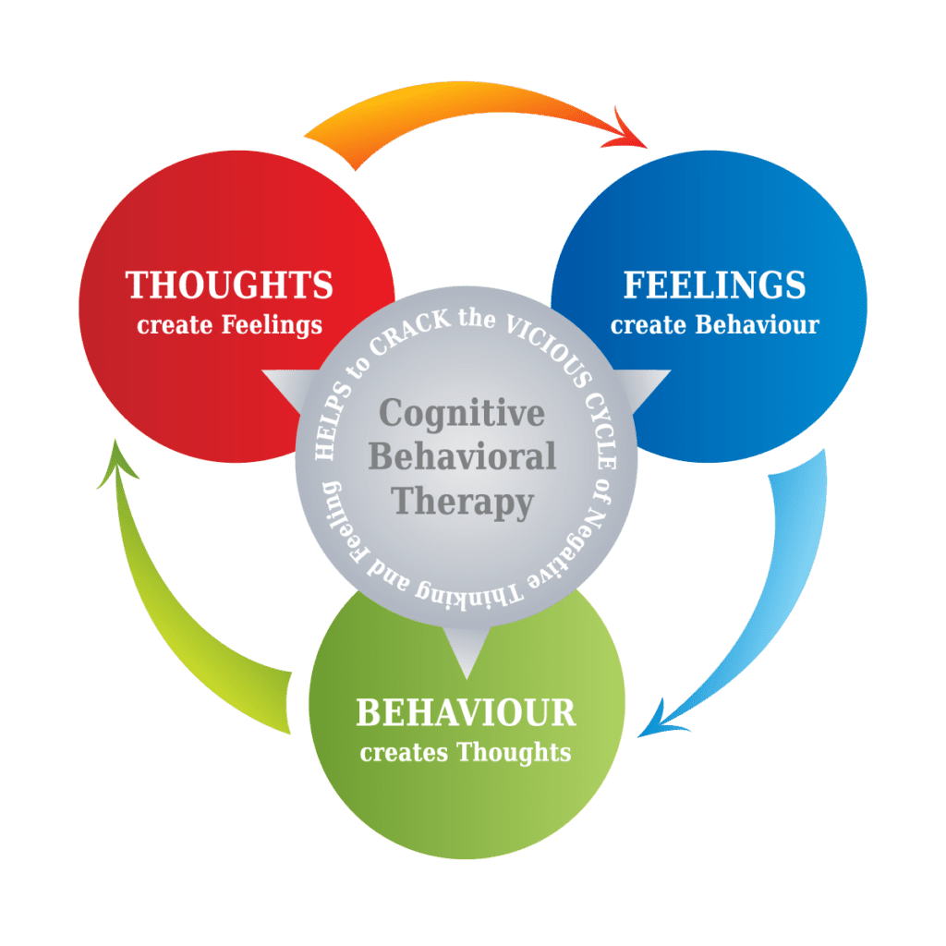
Behaviour is communication

Slide 6

It begins with positive relationships…
Time
Planning
Effort
Consistency

Slide 7
Evidence around Promoting Positive Behaviour
1
Know and understand your child and their influences
3
Use Strategies to promote good behaviour with sanctions that do not impact on self-esteem / self-perception
5
Use targeted / bespoke approaches to meet individual needs
2
Teach your child expected behaviours alongside managing misbehaviour
4
Simple approaches and regular routines

Slide 8








What about you?

Slide 9

Understanding the needs of your child
School-age children are constantly learning and exploring their world. They may have lots of questions as they start to form their own views on issues. As they move towards being more independent they may seem to push boundaries and become more challenging. This is a necessary part of growing up…

Slide 10

Setting boundaries…
Clear guidance simple and consistent
Opportunities for discussion and explanation
Be a role model
Consistently enforced

Slide 11

Rewards and Discipline
Recognise, Praise, Consistently
Consistently discipline – followed by restorative discussion
‘Reward’ key positive behaviours
Avoid rash decisions when angry that undermine your authority!

Slide 12


Slide 13
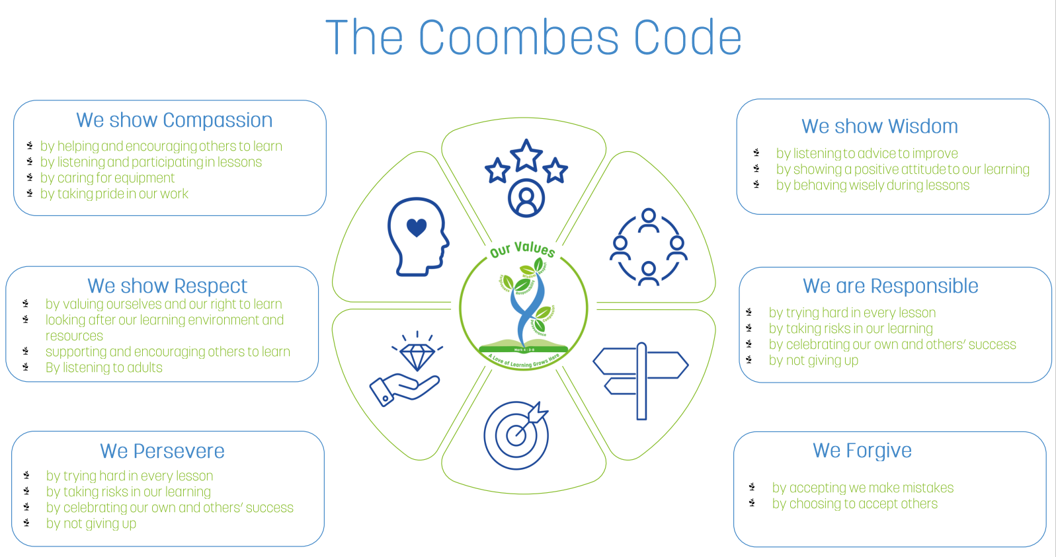
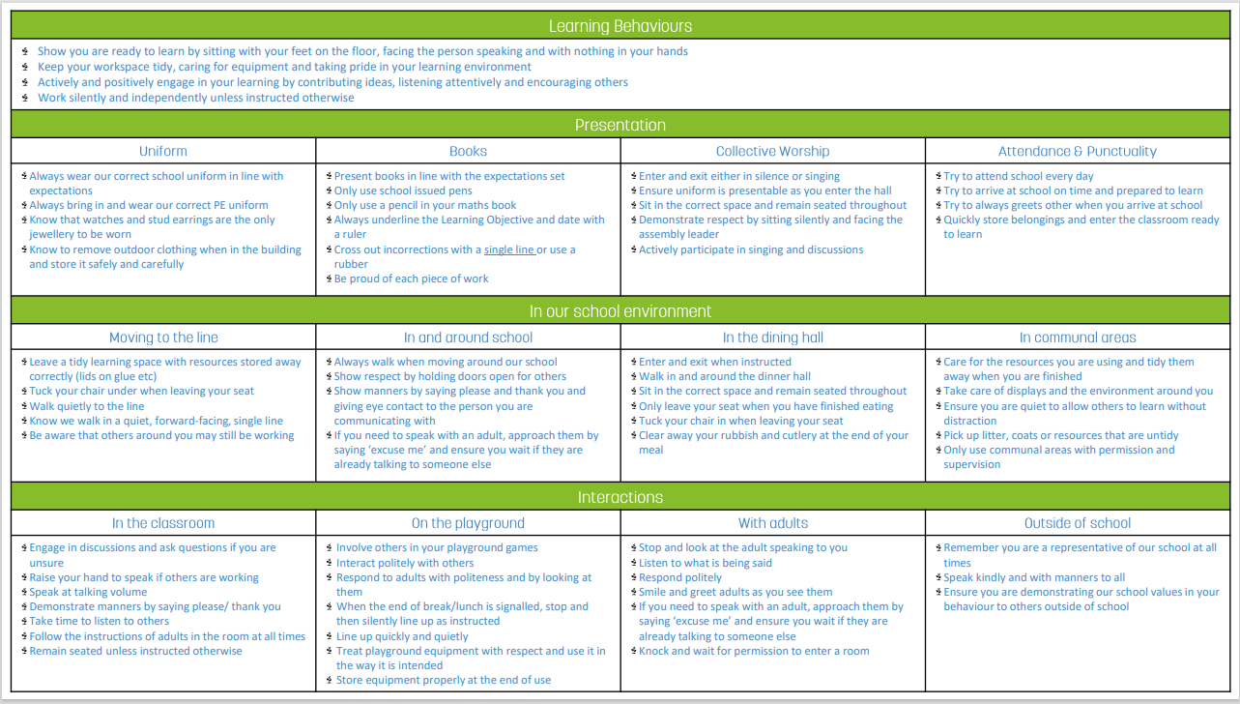
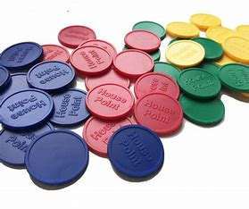


Behaviour in school
Linked to our school values
Behaviour Curriculum- Expectations

